Slide 1
PRINTER

Slide 2
Terminology
PPM (pages per minutes)
Seberapa cepat printer dapat mencetak
dpi ( dot per inch)
resolusi printer / berapa banyak titik per inchi yang dicetak oleh printer tersebut
Duplexing assembly
dapat melakukan pencetakan bolak balik

Slide 3

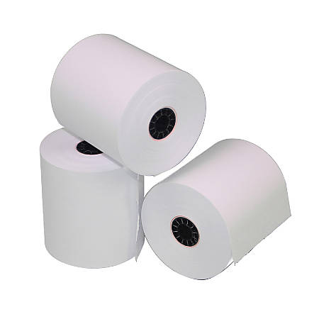
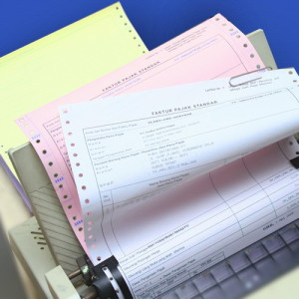
Jenis kertas
Single-sheet paper
Continous-feed paper
Thermal paper

Slide 4
Maintenance tools
Compressed air
Computer vacuum
Isoprophyl alcohol
WATER??

Slide 5
Komponen Laser Printer
Pickup rollers
Separator pads
Imaging drums
Toner
Transfer roler
Fuser
Transfer belts
Power supply

Slide 6
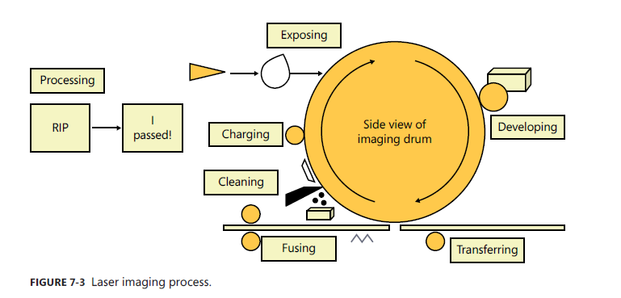
Laser printer Imaging Process

Slide 7
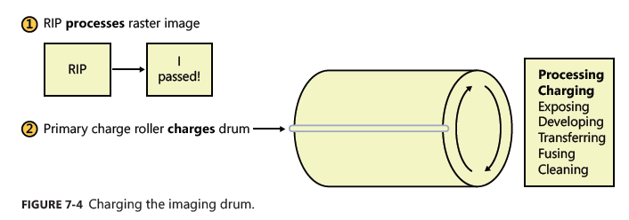
Laser printer Imaging Process
Processing
Charging

Slide 8
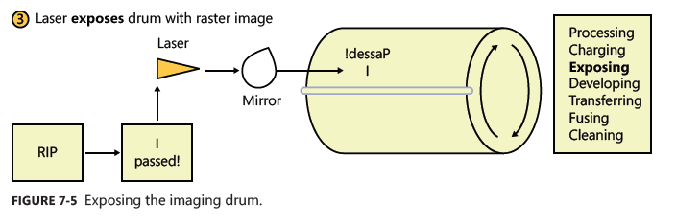
Laser printer Imaging Process
Exposing

Slide 9
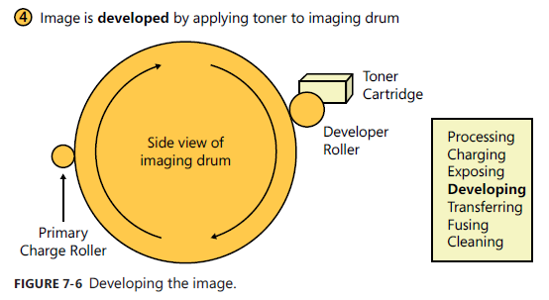
Laser printer Imaging Process
Developing

Slide 10
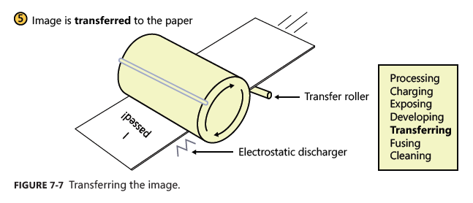
Laser printer imaging process
Transferring

Slide 11
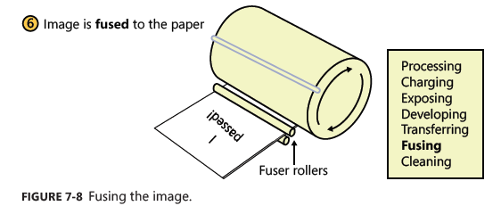
Laser printer imaging process

Slide 12
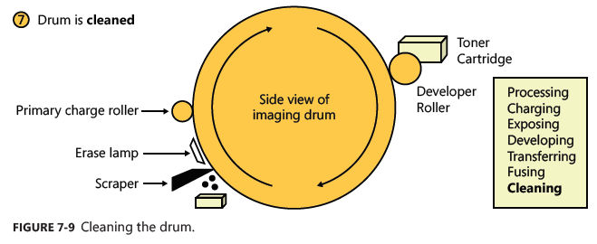
Laser printer imaging process

Slide 13
Video
https://youtu.be/PHxXmjxcAIo

Slide 14
Pertanyaan
Bisakah laser printer mencetak berwarna?

Slide 15
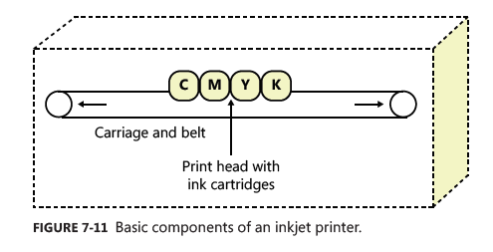
Inkjet Printers

Slide 16
Inkjet printing process
Thermal / Bubble jet printing
Piezoelectric

Slide 17
Thermal/Bubble jet printing
Small heater to heat the ink → small bubble, injected into the paper

Slide 18
Piezoelectric printing
Elektrical voltage -> vibrate crystal → eject the ink

Slide 19
Inkjet print heads
Disposable
Fixed

Slide 20
Problem
Inkjet calibration
Paper jam
Ink
Print heads

Slide 21
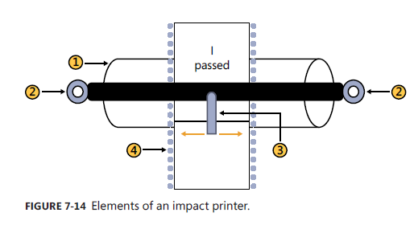
Impact printer

Slide 22
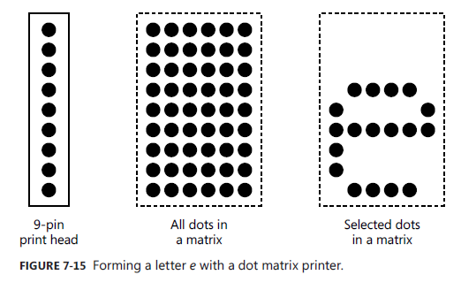
Membentuk karakter dengan dot matrix

Slide 23
Problem
Paper dust
Paper path
Ink ribbon
Print head
Platen

Slide 24
Thermal printer
Special paper with chemical coating
Change color with heating
Printer head include heating element

Slide 25
Issue
Device driver
Connectivity (wired/wireless/local/networked)
Printer sharing
Printer spooler

Slide 26
Other issue
Printer will not print
No connectivity—local printer
No connectivity—network printer
Paper not feeding
Creased paper.
Paper jam
Faded print.
Streaks on a laser printer.
Backed-up print queue.
Access denied.
Unable to install
Blank pages
Streaks on an inkjet printer
Ghost images due to image problem.
Ghost images due to hardware problem
Vertical lines on page.
Color prints in wrong print color.
Low memory errors.
Error codes
Toner not fused to the paper

Slide 27

THANKS!
Any questions?

